Slide 1

Gesture Driven Object Manipulation using YOLO in Unity

Slide 2
Team Members
Kankipati Venkata Meghana cb.sc.u4aie24022
Kondakindi Supriya cb.sc.u4aie24025
Korumilli Siva Kumar cb.sc.u4aie24027
M Mahendra cb.sc.u4aie24033

Slide 3
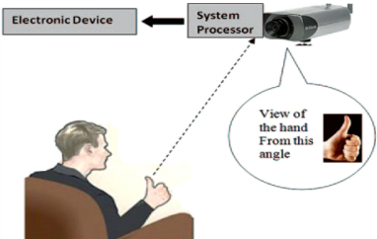
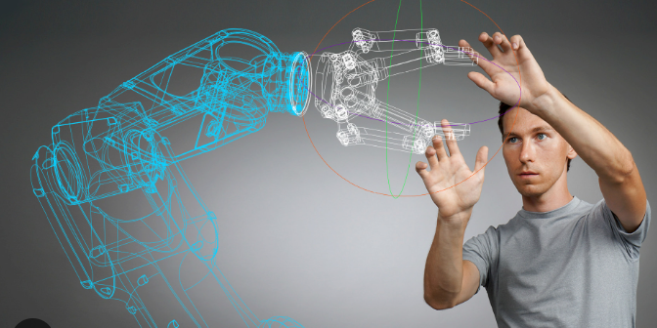
Our Topic..
Gesture based Object manipulation:
Regular methods of interaction (like mouse, keyboard) have
limitations, in creating immersive experiences for users.
Using gestures enhances user interaction,
is more intuitive and natural for a person.
It could be a new and normal way of
interaction in the future, with increasing
progress in computer vision

Slide 4
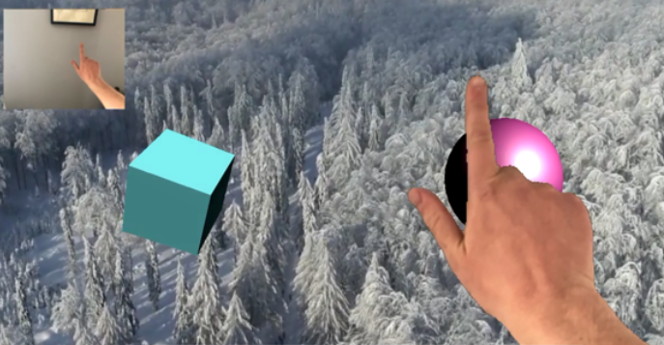
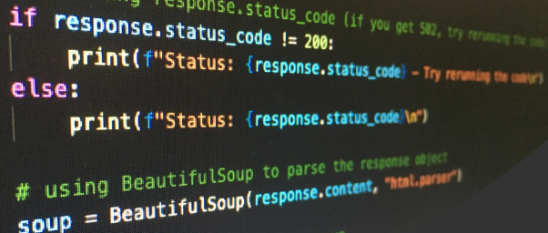
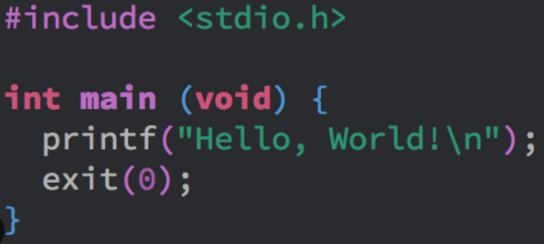
Software
High Level Languages: These are easy to use, closer to normal English, and abstract away low-level implementations. (EOC)
Python: Seamless integration with PyTorch. Beginner friendly, good for multi-purpose use. Ultralytics library provides pretrained variants of YOLO, which we are using (v5). (MFC)
Unity: A real time 3D development platform. Using it for showing the movement of an object within it, to move according to the gesture received. Is our user interface.
C#: Natively supported by Unity, to script the object in Unity according to the gesture imported from python.

Slide 5
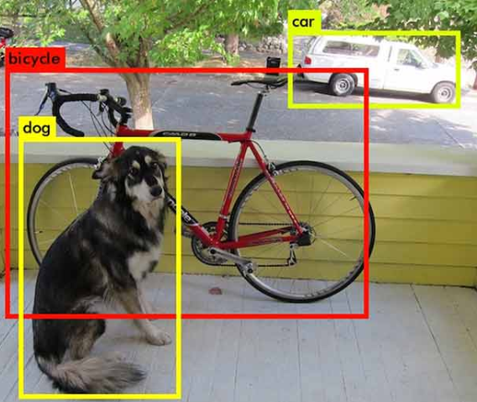
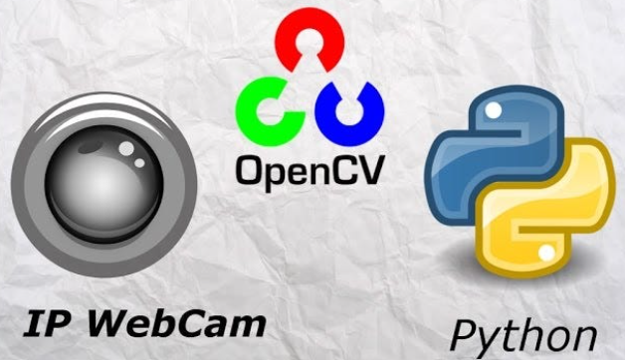
Tools
YOLO (You Only Look Once): A real-time object detection algorithm. Uses CNN (deep learning) to predict the class of an object in one pass, making it efficient for real world applications in real time.
OpenCV: An open source library which is specifically for computer vision related tasks. It can manipulate images, stream webcam inputs and extract images from videos.
TCP(Transmission Control Protocol)/UDP(User Datagram Protocol): Normal sockets. Can send and receive small amounts of data with lesser latency and complexity. TCP is slightly more complex and accurate, and UDP has a faster speed with lower latency, more suitable for real time.
Unity: Using it as a user interface, where the person can make the gesture in front of a webcam, and see the block moving in Unity.

Slide 6
Functioning of YOLO: A Brief Overview
YOLO uses the following concepts:
It divides the image into an nxn grid
It predicts bounding boxes which show the x,y coordinates (which fall on center of the grid box), and its height and width (w.r.t whole image)
Each grid then decides the confidence score, whether the object
is in the box or not.
It uses a logistic function to predict bounding boxes, class prob.
A loss function is used to measure loss in accuracy
Non max suppression is used to avoid multiple detections of
same object

Slide 7
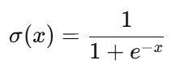
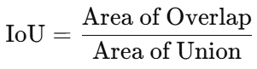
Functions:
Formulae Name | What it does | Formula | Relevance in YOLO
Sigmoid (Logistic) Function | Squashes real values between 0 and 1, used for probabilities |  | Object Confidence score Class probabilities
Loss Functions | Tells model how wrong its predictions are | YOLO loss = Localization + Confidence + Classification loss. | Localisation, classification, confidence losses (b.box, obj. class labels, correct detection)
Non-Max Suppression | Selects best bounding box with highest confident score |  | Ensures only 1 bounding box per object

Slide 8
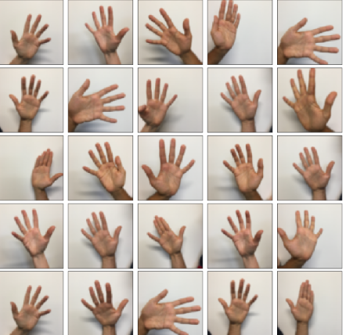
Datasets available and used in papers-
Datasets Used + Available Datasets online:
HAGR1 Dataset
Leap Motion Dataset
EgoHands Dataset
We aim to create a custom dataset, and use it to train the model instead. (due to lesser no. of gestures we plan to implement, and hardware constraints for training

Slide 9
Paper 1: 3D interaction techniques using gesture recognition in virtual environment- 2015
Developed a 3D interaction technique 'selection/manipulation' using gesture recognition in virtual environment
Methodology: combining multiple sensors (with data gloves), use a fused system of Leap Motion and gForcePro+ for gesture recognition
Advantages: A practical way of interaction, with a fusion of multiple sensors
Limitations: Background and lights significantly impact accuracy
Metrics: Errors due to bad detection were minimised

Slide 10
Paper 2: Force Push: Exploring Expressive Gesture to Force mappings for Indirect 3D object manipulation- 2018
Incorporates elements of gestures and physics based techniques for object manipulation in VR
Methodology: Uses physics driven movement to simulate realistic object behavior in response to a gesture, by dynamic mapping compared to direct controlled methods
Advantages: It can work with coarse and precise manipulation, giving a more satisfying user experience
Limitations: Lesser accuracy than traditional methods, performs less effectively when initial distance between user and object is too less
Metrics: Performed better on average, evaluated using a survey

Slide 11
Paper 3: Fingertip interaction method in handheld augmented reality for 3D manipulation- 30 Oct 2020
Interacting directly with virtual objects and manipulating it using fingertip based gestures in handheld AR, performing translation, rotation or scaling
Methodology: Using Leap Motion sensor to track motion of skeletal structure of hand after analysing the calibration of hand through raw data
Advantages: User can use finger tips to perform actions through the device, instead of using touchscreens or buttons.
Limitations: Has delays, as we use internet connection to process information. Limits scalability, as it is built for single user
Metrics: Performed better using touchscreen than control using fingertips

Slide 12
Paper 4: Unified Learning for Egocentric Hand Gesture Recognition and Fingertip Detection- 20 July 2021
Focuses on egocentric hand gesture and fingertip detection, especially in VR headsets.
Methodology: A single CNN pass predicts both finger class probability and fingertip position.
Advantages: High efficiency, real-time performance.
Limitation: Large network architecture and limitations in datasets
Metrics: 99.9% accuracy, 0.99 F1 score, lower pixel error
They've used i7 cpu, with a NVIDIA 2070 Super GPU

Slide 13
Paper 5: Real-time object detection with deep learning for robot vision on mixed reality device 11 March 2021
Integrates Microsoft Hololens and YOLO for real-time object detection for robotic vision, enhancing human-robot interaction in AR
Methodology: Hololens captures real time video stream, transmits to Ubuntu server using Rosebridge API. It then uses ROS and YOLOv4. Unity3D and HololensCameraStream plugin
Advantages: Enables real time object detection using AR devices, v4 better at detecting smaller objects
Limitation: lower FPS for v4 than v3, due to lower-end hardware.
Metrics: 13 FPS for video stream, 28 FPS for v3, 13 FPS for v4

Slide 14
Paper 6: A novel gesture recognition technique based on SEMG armband and Leap motion controller- 2022
Integrates SEMG signals from an armband, with motion data from Leap Motion controller to detect a gesture to enhance accuracy
Methodology: The controller uses infrared camera and tracks position of hand palm and fingertips, SEMG armbands detect muscle activity, deciding the gesture by differentiating forces
Advantages: higher accuracy due to considering palm, fingertips, and muscle accuracy and combining them
Limitations: orientation of armband might change every time user wears it, leading to inconsistent signals
Metrics: Measures correct gesture recognition using sensor signals, evaluates grasping and gesture response time based on real time

Slide 15
Paper 7: Application for python programming language education, developed by Unity engine- 2022
Introduces interactive gaming-based education, to teach python language in Unity.
Methodology: Using Unity to create an interactive 2D platform teaching fundamental python programming, surveys were conducted before and after to analyse effectiveness.
Advantages: Unity's immersive and interactive environment can enhance student engagement. It can be used to develop virtual labs, while Python can be used for data analysis and modeling.
Limitations: Requires proficiency in Unity and Python, which can be a barrier.
Metrics: Entry and exit surveys were used to evaluate players' programming skills with feedback

Slide 16
Paper 8: A study in hand gesture recognition algorithm realised with the aid of efficient feature extraction method and convolution neural networks: design and its applications to VR environment- 15 July 2023
Explores real time VR interaction using TOF depth sensors, with simple control interface and pattern recognition techniques
Methodology: Uses TOF cameras for depth info (can work in low light or complex backgrounds). Hand shape recognition(fingertip, palm center) using CNN (YOLO) and thinning for preprocessing
Advantages: Adapts to challenging conditions, as they base it on depth analysis
Limits: Increase in cost, uses more hardware (TOF cameras) for training and use
Metrics: Precision of 99.98%, and classification rate of test data
Used 2 different gesture datasets for training

Slide 17
Paper 9: Deep learning empowered hand gesture recognition: using YOLO techniques- 2023
Compared model analysis of YOLO v5, v6, v8, focusing on real time hand gesture recognition
Methodology: Used different versions of YOLO to detect hand gestures. Prepared a dataset with 5000 hand gesture images, labelled using Roboflow platform, split into train, validation and test datasets.
Advantages: Real time gesture recognition of multiple gestures simultaneously
Limitations: Need high quality datasets and huge computational resources
Metrics: Results measured using accuracy and speed

Slide 18
Gaps in papers, Our Novelty
Gaps:
They used YOLO for gesture detection, but need extensive resources (like a Super GPU funded by NVIDIA), or used specific tools(like the TOF cameras) for high accuracy in object detection. VR interaction was done mostly through headsets (Hololens), or Leap Motion (sensor-controller).
All of these require additional hardware or tools, or more computation.
Novelty:
Our approach is to implement a pipeline, use inbuilt webcam and an entry level GPU for gesture-based object manipulation, without any external hardware or tools.
This can reframe how we view gesture-based interaction: not just as something related to 'gaming', but as a practical way for anyone to interact with a computer.

Slide 19
Problem Statement
This traditional way of interaction with virtual environment involves the usage of controllers, which limits the user-based interaction.
With the use of Gestures, a user can effectively engage with AR/VR to have a better experience. Our project has high scope as improved computer vision methods are developed and make a new base for user-system interaction.
This project aims to develop a gesture-driven object manipulation system in Unity using YOLO, leveraging deep learning-based object detection for fast and reliable gesture recognition. The system will enable real-time object control, improving interaction efficiency and user experience in 3D environments.

Slide 20
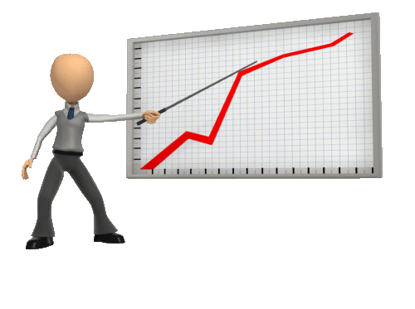
Methodology
Stream in webcam input in real time, convert it into frames using OpenCV.
Send the frames continuously to the YOLO model, which will detect an object(if present) and store it in a variable within python.
Using UDP/TCP sockets(used for smaller data), continually sync the variable data to Unity. This method is better than the ROS(better for hardware integrations) or Websockets(used in webpages), as the data synced is very small, having low latency.
The data is received in Unity, and by scripting in C#, we make the object previously imported into unity, to move according to the content/gesture detected in the variable synced.

Slide 21
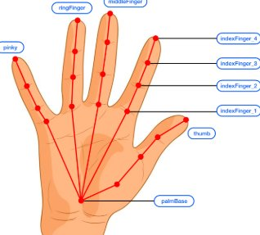
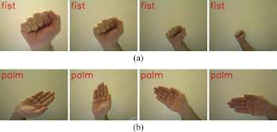
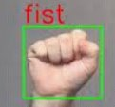
Dataset
We're trying to use a custom dataset of fists and palms of different people, to train the pre trained YOLOv5 model, so that it detects a fist and a palm with reasonable accuracy.
To prepare the dataset, we're using Roboflow, a website which can continually take pictures and auto annotate some of them. Then we adjust the bounding boxes for the train dataset, and save it.
We're aiming for around 150-300 images per class, and will try experimenting with the parameters of YOLO in case the gestures aren't detected accurately.

Slide 22
Progress
So far, we've tried creating a sample dataset of 20-30 images and annotating it.
We've set up OpenCV, ultralytics and CUDA (for GPU acceleration )
We've set up YOLOv5 on our system, and tried verifying its capability by trying out different pictures from its pretrained classes. It could predict cars correctly
We've also set up Unity on our system, and tried tinkering with it. We tried scripting on a sphere, but did not really implement any if-else conditions or while loop, that we'd need for our project.

Slide 23
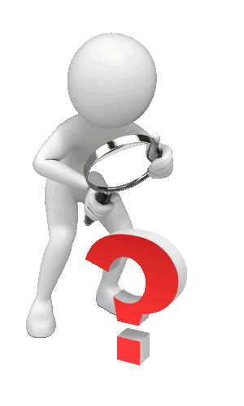
Final Aim, Challenges
By the end of the semester, we plan to have a working prototype, of the whole pipeline.
Challenges:
Resources usage, managing the software (especially Unity and YOLO) with our current system hardware (an entry-level GPU), probably having to use Google Colab if needed would be a potential challenge.
Achieving it in real time without much lag, would be another, very likely problem. Especially since we're using a variant of YOLO, the YOLOv5, on a lower-end GPU. If it significantly lags, we'd try using UDP instead, and try using YOLOv3.
Using a custom dataset might cause inaccuracy as we would have lesser images. The YOLO variants are trained with the COCO dataset, with millions of images. We can try increasing dataset size or changing some parameters (like learning rate and confidence thresholds) to improve accuracy. We can also try with untrained YOLO model and train it with only our custom dataset.

Slide 24
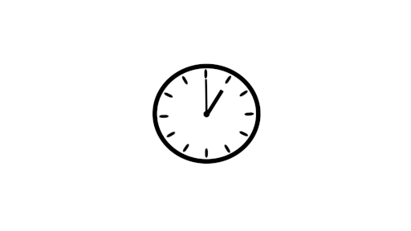
Timeline
1 week- setting up TCP, UDP, preparing custom dataset
1 week- Streaming in webcam input as frames to YOLO and checking for object detection
1 week- training YOLO with custom dataset and testing to ensure it detects gestures.
1 week- figuring out writing custom code in Unity
1 week- connecting YOLO's output in python to Unity in c#, using the TCP or UDP
1 week- testing it actually works
1 week- getting performance as close to real time as possible
Total: 6-7 weeks, ~1.5 to 2 months
THANK YOU !
We are Group 6..

